Slide 1
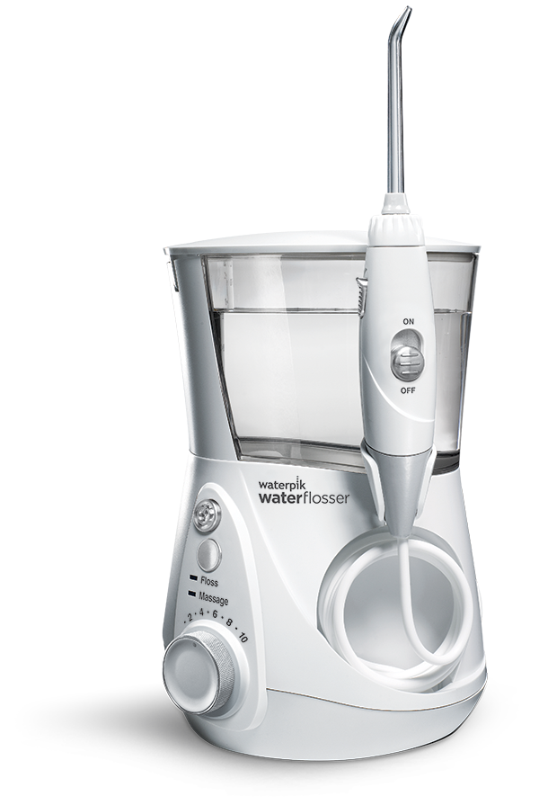
the Most Popular Countertop & Cordless Models
4
On/Off Water Control on Handle
Three Year Limited Warranty
Jet Tips Included
Two Year Limited Warranty
1 Minute Timer and 30 Second Pacer
90 + Second Water Capacity
3 Pressure Settings
Global Voltage
7
Waterproof Design Use In The Shower
10 Pressure Settings
For Optimum Control
All 7 Tips Included

