Slide 1
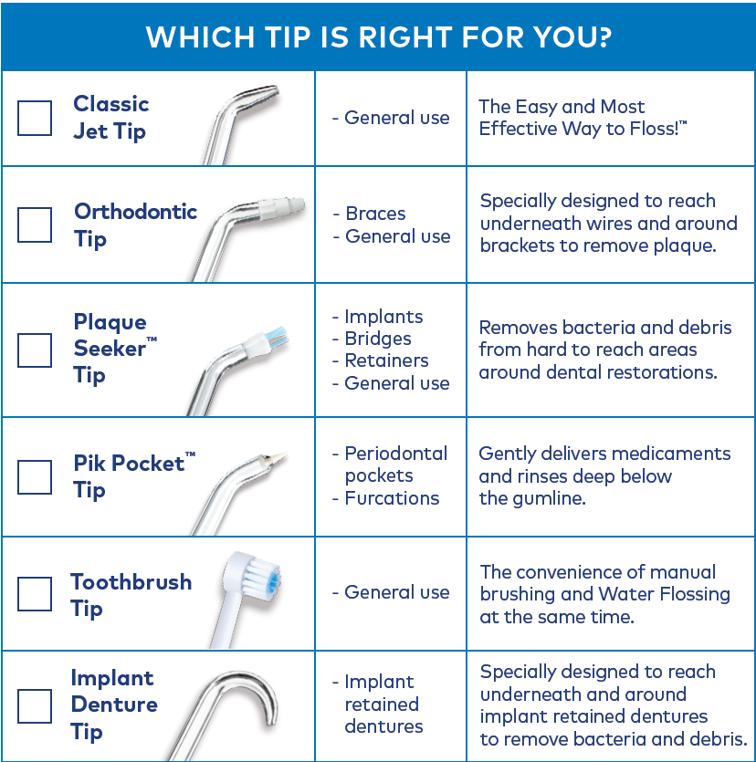
Tips For Customizing Individual Needs
Tip Guide is located inside the Waterpik® Patient Education Brochure. Helps you show your patients which tip is best for them to use!

