Slide 1
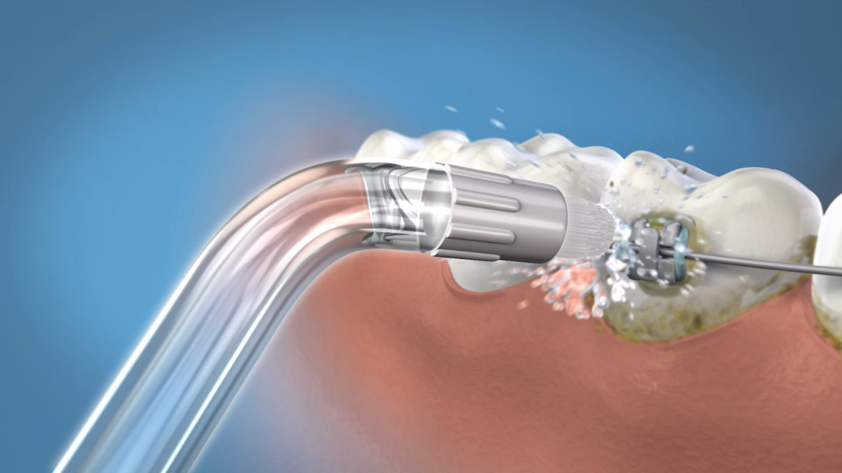
Waterpik® Water Flosser Is the Ideal Tool
for Orthodontic Patients
5X more effective at removing plaque than brushing alone
3X more effective at removing plaque than brushing and flossing
Sharma NC et al. Am J Orthod Dentofcial Orthop, 2008; 133:565-571
Notes:
There is no better tool for a patient with orthodontic appliances than a Water Flosser. This study was conducted on teens who used the WF daily and employed the specialized orthodontic tip. The result showed the WF was 5 times more effective than brushing alone and 3 times more effective than brushing and flossing.
{insert personal story about how WF helped one of your orthodontic patients – or yourself while in ortho}

