Slide 1
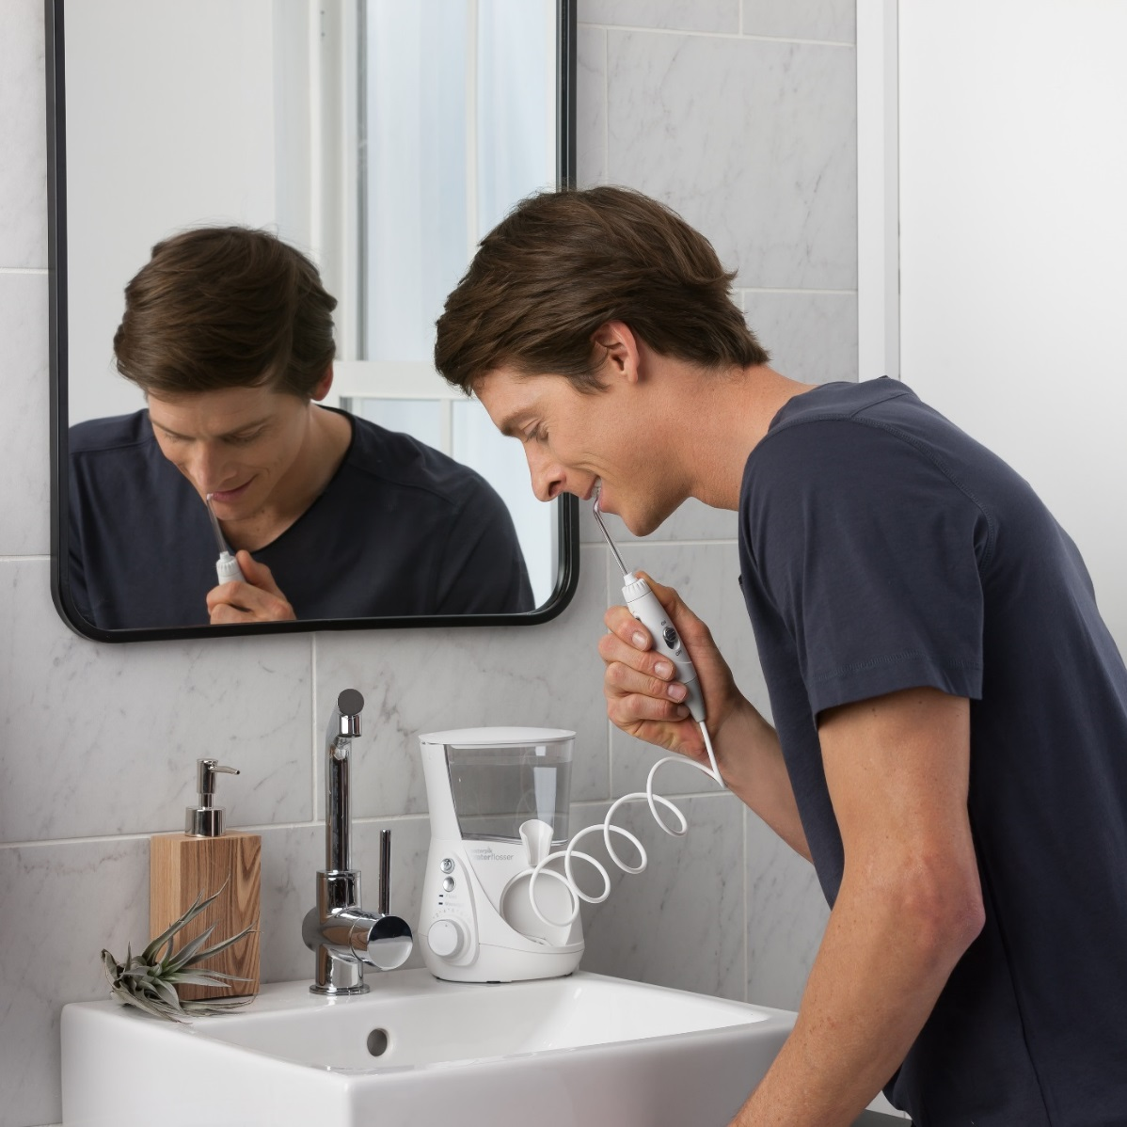
How To Use The Water Flosser
Use warm water
Start on lowest setting and slowly increase pressure
Place jet tip or brush head in mouth and bend over the sink
Most antimicrobial agents can be used in reservoir
Flush with water after use
Reservoirs are dishwasher safe and BPA free

