Slide 1
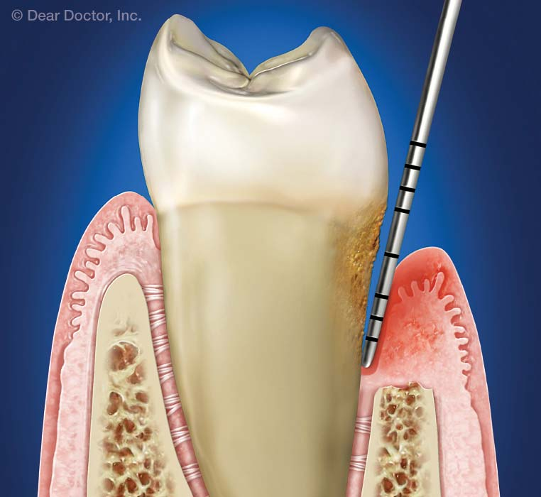
Water Flossing With Water Shown Highly Effective
for Periodontal Maintenance Patients
Reduced BOP by half over a 6 month time frame.¹
Was more effective than rinsing with 0.12% CHX at reducing BOP.²
Reduced inflammatory mediators associated with bone and attachment loss.³
44% more effective than routine oral hygiene at reducing bleeding in people with diabetes.⁴
Flemmig TF et al. J Clin Periodontol 1995; 22:427-433
Flemmig TF et al. J Periodontol 2009; 61:112-117
Cutler C et al. J Clin Periodontol 2000; 27:134-143
Al-Mubarak S et al. J Clin Periodontol 2002; 29:295-300

