Slide 1
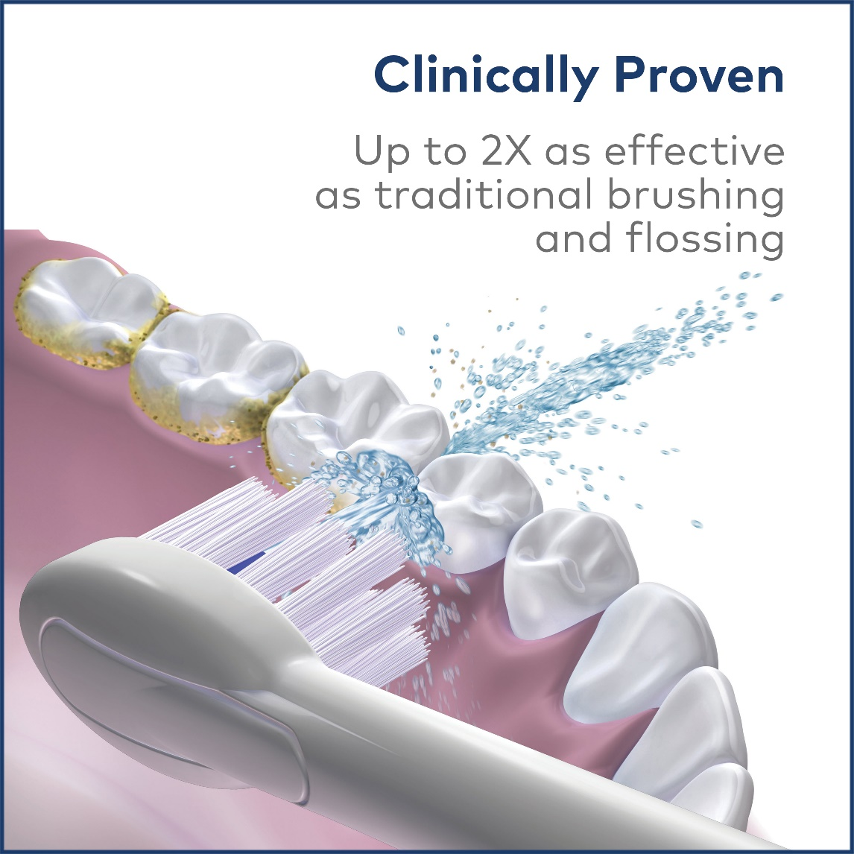
Brush & Floss Control on Handle
Three Year
Limited Warranty
Space Saving Design
Ten Pressure Settings
Water Flossing
Brush Heads
LED Mode
Indicators
3 MODES
Just Brush, Just Floss Or
Brush & Floss At The Same Time

