Slide 1
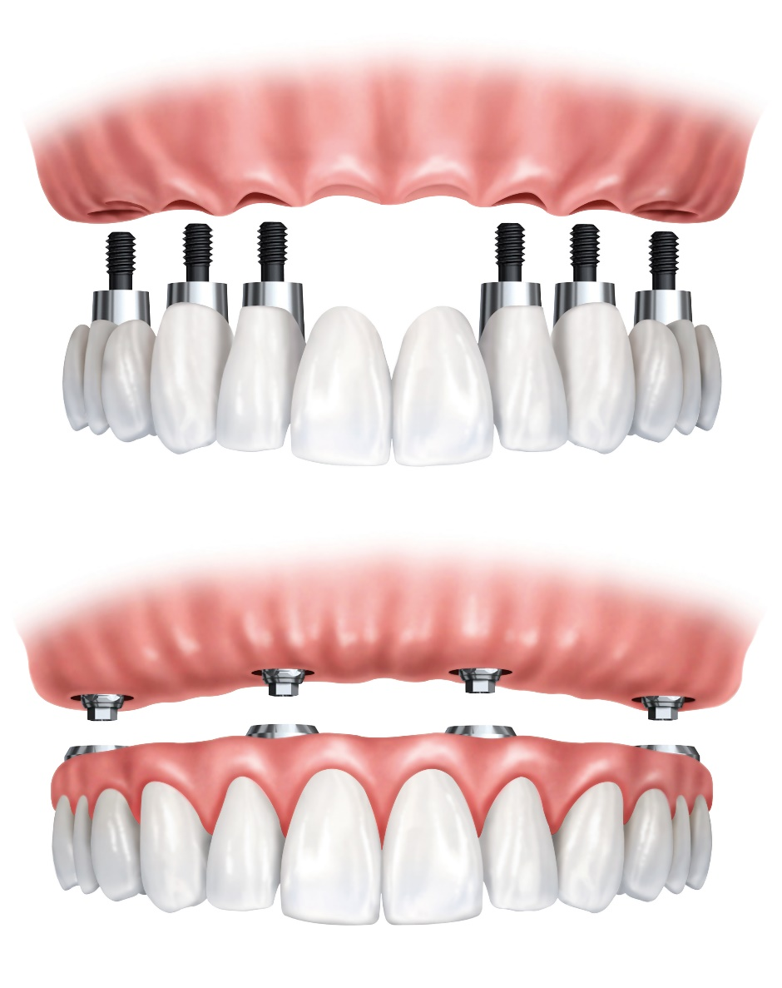
What about full or partial dentures retained with implants?
Introducing the Implant Denture Tip
Notes:
While the Plaque Seeker® Tip is great for single implants, it is far more challenging to clean a full or partial denture retained with an implant. Most of us have likely seen first hand just how much accumulation there can been under that implant retained denture. Over the years, many people have been asking ifWaterpik® can develop something to help – and I am so excited to tell you that they have! It is called the Implant Denture Tip. I think the best way for you to see how it works is to watch the video. The tips are available from Waterpik®– they come in packets of 2, just like the other tips. As far as a study, it was interrupted by COVID, so they have had to start it over so look for that data next year.

