Slide 1
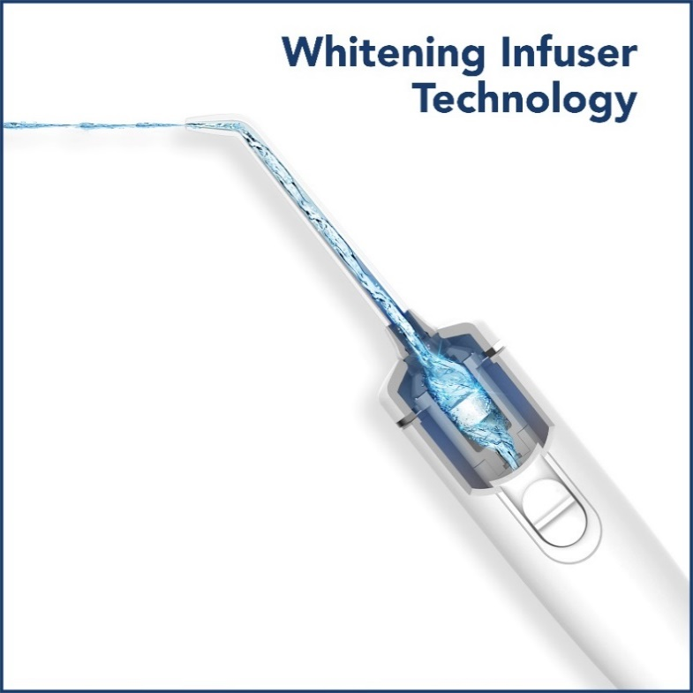
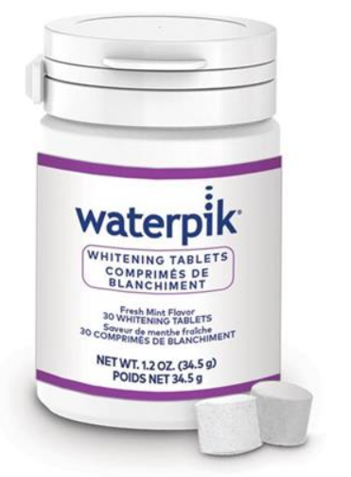
Naturally Whiten Your
Teeth While You Water Floss!
4
On/Off Water Control on Handle
Tips Included
10 Pressure Settings
Optimum Control
Three Year Limited Warranty
30 Day Supply Of whitening Tablets
Notes:
Highlight important product features. [The product slides are the perfect opportunity to mention the trial unit price. The L&L trial unit price for Whitening is $49.99]. MSRP is $99.99.

