Slide 1
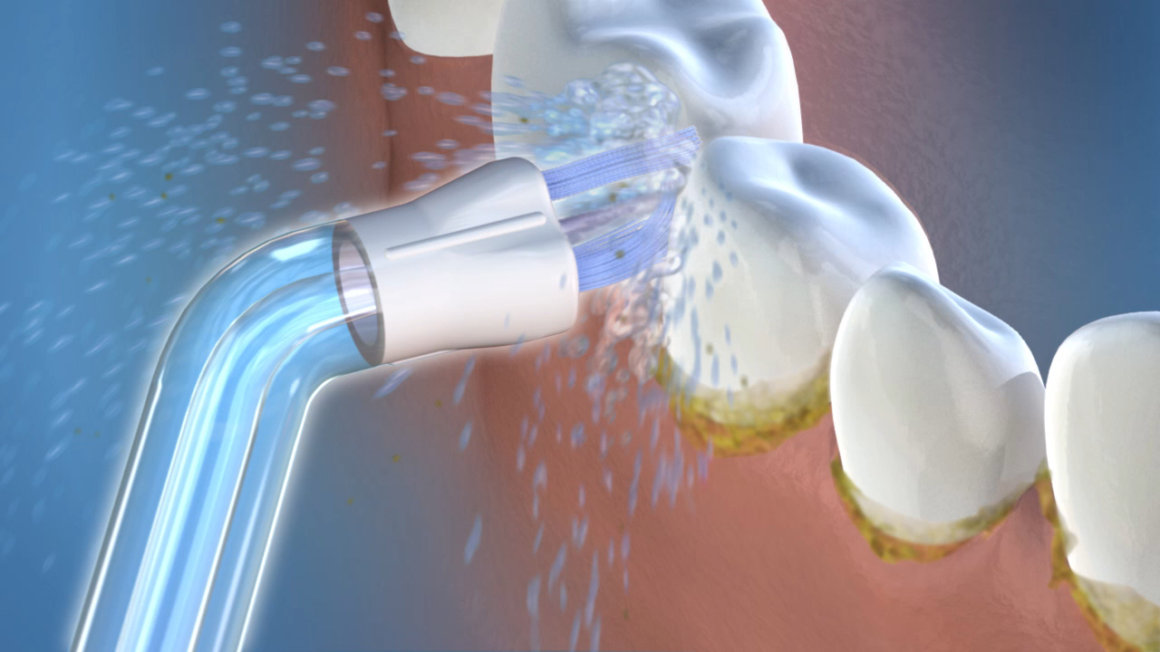
Compared To String Floss, The Plaque Seeker® Tip Is More Than 2X As Effective At Reducing Bleeding Around Implants And Is Safe To Use
Magnuson B et al. Compend Contin Educ Dent 2013; 42(Special Issue 8): 2-7

