Slide 1
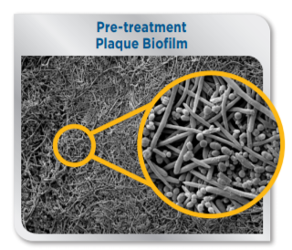
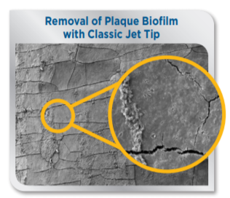
Water Flossing Is Clinically Proven To Remove Plaque
A benchmark study conducted at USC found that the shear hydraulic forces produced by the
Water Flossing significantly remove up to 99.9% of plaque biofilm from treated areas.
Gorur A, Lyle DM, Schaudinn C, Costerton JW. Biofilm removal with a dental water jet. Compend Cont Educ Dent 2009; 30(Special issue 1): 1–6.

