Slide 1
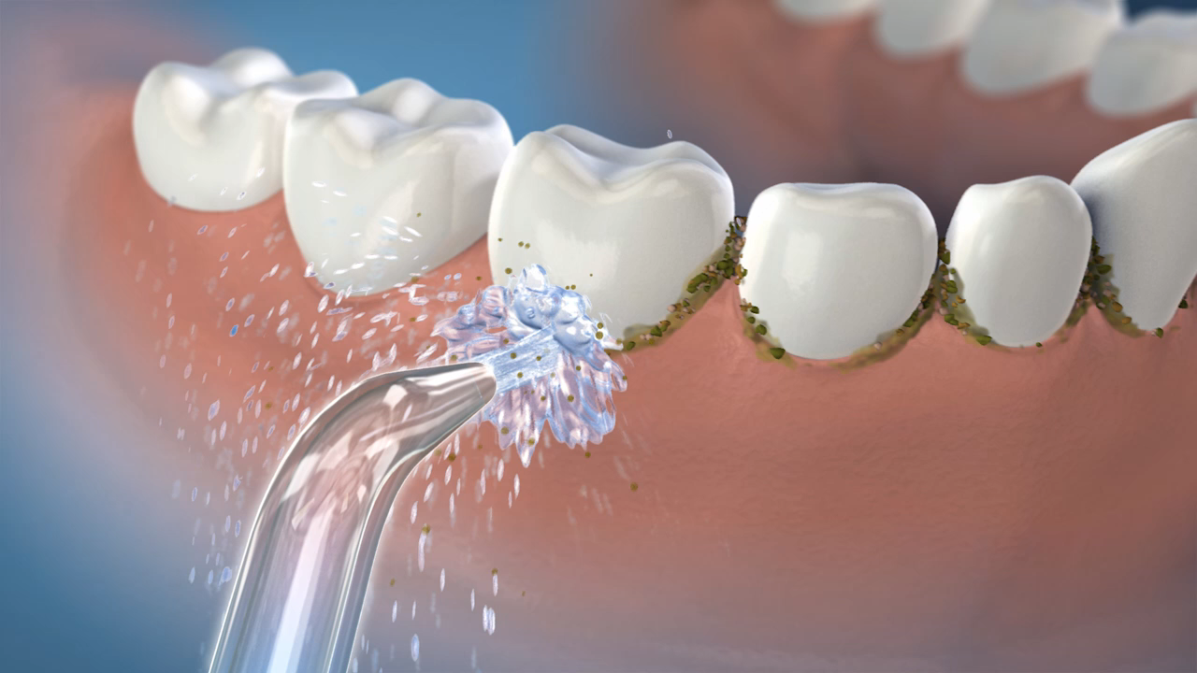
Six Studies Have Compared The Water Flosser To String Floss¹⁻⁶
Study Findings:
50% more effective for reducing gingivitis¹
29% better for plaque removal³
3x as effective as string floss for ortho patients⁴
2x as effective as string floss for implant patients⁵
Barnes CM et al. J Clin Dent 2005; 16:71-77
Rosema NAM et al. J Int Acad Periodontol, 2011;13(1):2-10
Goyal CR, et al. J Clin Dent 2013; 24(2):37-42
Sharma NC et al. Am J Orthod Dentofcial Orthop, 2008; 133:565-571
Magnuson B et al. Compend Contin Educ Dent 2013; 42(Special Issue 8): 2-7
Goyal CR et al. Compendium Contin Educ Dent 2018; 29(Suppl 2): 14-22.
Notes:
6 studies have compared the Waterpik® Water Flosser to string floss including studies with people in ortho or who have implants. In each instance, the WF was shown to be significantly more effective than string floss for improving gingival health. Notably, the WF is 50% more effective for reducing gingivitis and 29% more effective for plaque removal.
{Insert success story about how WF improved the oral health of one of your non flossing patients.}

